Slide 1
Хаккатон

Slide 2
Purpose
The objective of the competition is to correctly predict lithology labels for provided well logs, provided NPD lithostratigraphy and well X, Y position.

Slide 3
Input data
Jupyter Notebook
Training dataset
Testing dataset

Slide 4
Description of the Datasets
Metadata
Well logs
Interpretation
WELL: well name
DEPTH_MD: measured depth
X_LOC: UTM X coordinate
Y_LOC: UTM Y coordinate
Z_LOC: DEPTH
GROUP: NPD lithostratigraphy group
FORMATION: NPD lithostratgraphy formation
BS: Bit Size
CALI: Caliper
RDEP: Deep Resistivity
RHOB: Bulk Density
GR: Raw gamma data
SGR: Spectral Gamma Ray
RMED: Medium Resistivity
ROP: Rate of Penetration
NPHI: Neutron Porosity
PEF: Photoelectric Absorption Factor
RSHA: Shallow Resistivity
DTS: Sonic (Sheer Slowness)
DTC: Sonic (Compressional Slowness)
FORCE_2020_LITHOFACIES_LITHOLOGY: lithology class label
FORCE_2020_LITHOFACIES_CONFIDENCE: confidence in lithology interpretation (1: high, 2: medium, 3: low)
Shape : (1170511 , 29)

Slide 5
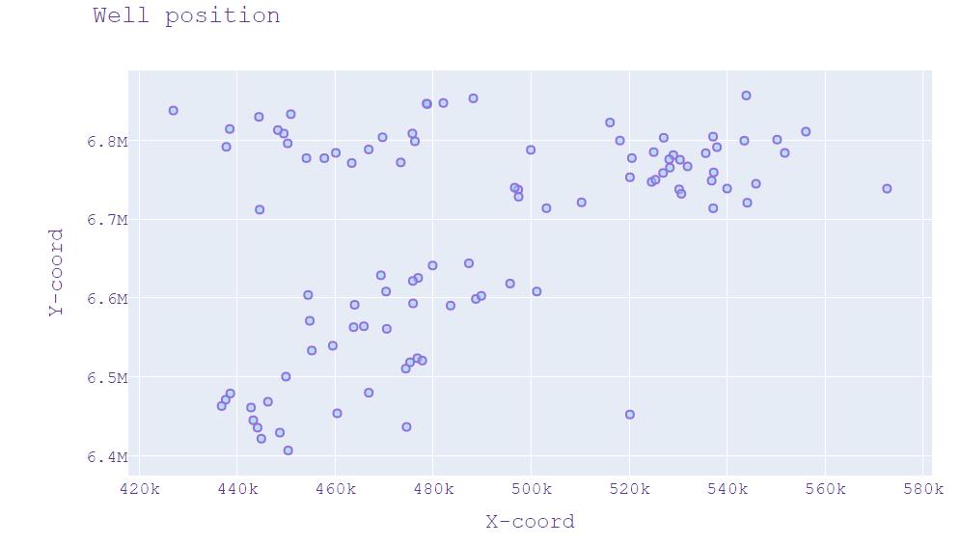
Metadata. Wells
There is a total of 83 wells in the training dataset

Slide 6
Metadata. Formation’s groups
There is a total of 14 groups of, formations in the training dataset
BAAT
CROMER KNOLL
DUNLIN
HEGRE
HORDALAND
NORDLAND
ROGALAND
ROTLIEGENDES
SHETLAND
TYNE
VESTLAND
VIKING
ZECHSTEIN
BOKNFJORD

Slide 7
Metadata. Formations
Each group includes a certain number of formations
There is a total of 86 formations such as following:
Aasgard
Agat
Amundsen
BASEMENT
Balder
Blodoeks
Broom
Bryne
Burton
Cook
Drake
Draupne
Egersund
Eiriksson Mb.
Ekofisk
Etive
Farsund
Fensfjord
Flekkefjord
Frigg
Grid
Grid Mb.
Hardraade
Heather
Heimdal
Hermod Mb.
Hidra
Hod
Hugin
Intra Balder Sst.
Intra Draupne Sst.
Intra Heather Sst.
Johansen
Jorsalfare
Krossfjord
Kupferschiefer
Kyrre
Lista
Lunde
Mandal
Mime
Ness
Oseberg
Ran Sst Mb.
Rannoch
Raude Mb.
Roedby
Sandnes
Sele
Skade
Skade Mb.
Skagerrak
Sleipner
Smith Bank
Sognefjord
Sauda
Tryggvason
Tuxen
Ty
Ty Mb.
Ula
Utsira
Vaale
Sola
Statfjord
Svarte
Tarbert
Tau
Tor

Slide 8
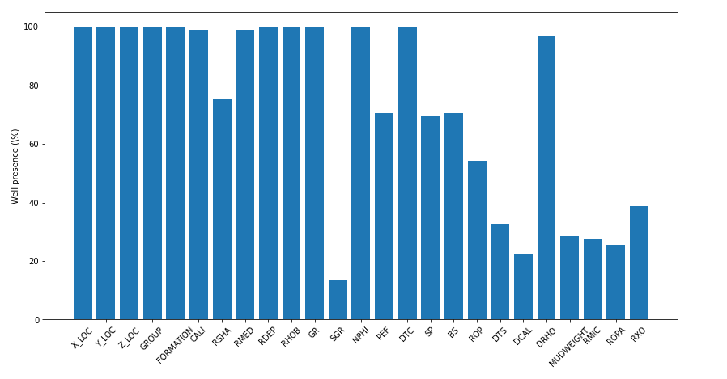
Well logs
There is a total of 21 types of well logs
Percentage of training data wells contain at least some depth interval with the given logs
Notice that some of the curves are NaN. This is an imporant aspect of this dataset and of this competition. The only log columns that are guaranteed to be present are WELL, DEPT, and GR. All other logs can (and will) be missing from some parts of the dataset.

Slide 9
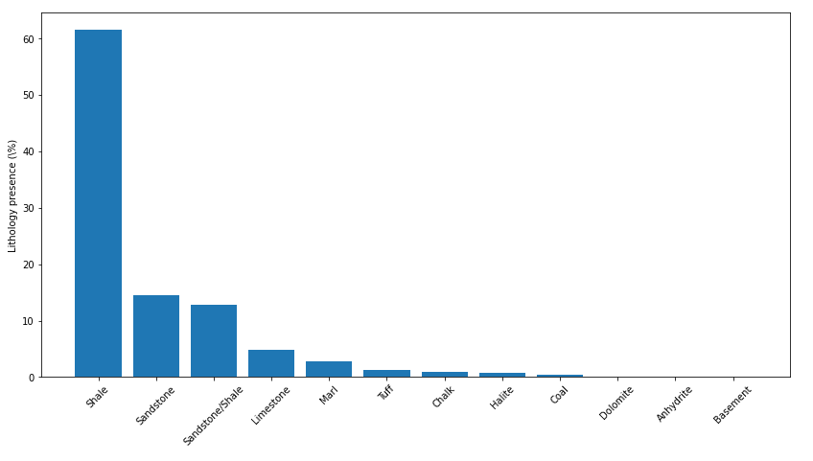
Interpretation
There is a total of 12 lithology class
30000: 'Sandstone',
65030: 'Sandstone/Shale',
65000: 'Shale',
80000: 'Marl',
74000: 'Dolomite',
70000: 'Limestone',
70032: 'Chalk',
88000: 'Halite',
86000: 'Anhydrite',
99000: 'Tuff',
90000: 'Coal',
93000: 'Basement'}

Slide 10
Proposed Workflow
Поиск и удаление
аномальных значений
Удаление значений каротажей, которые могут быть
не корректны за счет влияния каверн (washouts)
Determine bad hole sections in order to reduce the
weighting of the log values in the training
Восстановление пропущенных значений
Создание нескольких моделей для групп с различными свойствами (формация/литология?)
Создание 1 модели по всем данным
Гипотеза 1
Гипотеза 2
Каждая группа вмещает в себя
определенную литологию
Каждая литология обладает
характерными значениями по ГИС
Некоторые литологии обладают
схожими свойствами и их можно объединить

Slide 11
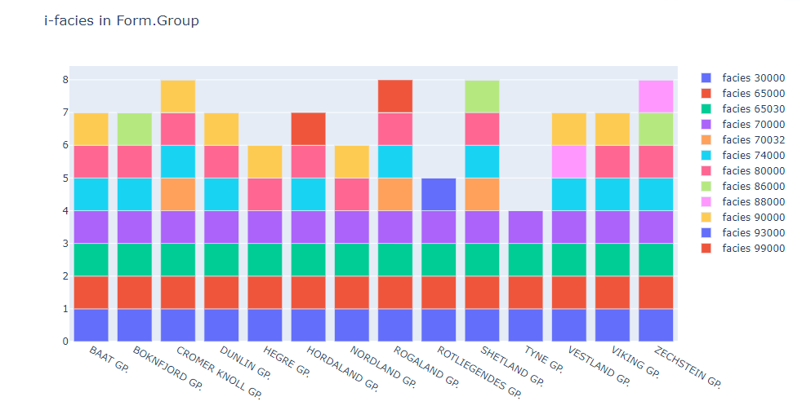
30000: 'Sandstone',
65030: 'Sandstone/Shale',
65000: 'Shale',
80000: 'Marl',
74000: 'Dolomite',
70000: 'Limestone',
70032: 'Chalk',
88000: 'Halite',
86000: 'Anhydrite',
99000: 'Tuff',
90000: 'Coal',
93000: 'Basement'}

Slide 13
Proposed solution
CatBoostRegressor – in order to fill NaN cells in training dataset
CatBoostClassifier, - in order to do classification

Slide 14
Links
Discussion
https://forum.xeek.ai/c/force-well-logs/7,

